Slide 1



Horizon Europe: What’s new
in Pillar II
Perry Guess
Horizon Europe National Contact Point, Cross-Cutting
Innovate UK
NCP-CrossCutting@iuk.ukri.org

Slide 2



Structure of Horizon Europe
Pillar I
Pillar II
Pillar III
Excellent Science
Global Challenges European Industrial Competitiveness
Innovative Europe
European Research Council
Health
Culture, Creativity and Inclusive Society
Civil Security for Society
Digital, Industry and Space
Climate, Energy and Mobility
Food, Bioeconomy, Natural Resources, Agriculture and Environment
European Innovation Council
Marie Skłodowska-Curie Actions
European Innovation Ecosystems
Clusters
Research Infrastructures
European Institute of Innovation & Technology
Joint Research Centre
€24.9bn
€53.8bn
€13.4bn
Widening Participation and Strengthening the European Research Area
Widening participation and spreading excellence
Reforming and enhancing the European R&I system
N.B. Budgets shown are for 2021-2027. Budgets are higher than above when the UK and other Associated Country contributions are included.
Key
Open to all research and innovation fields
Challenge driven – must solve the problem posed – not bottom-up idea driven

Slide 3
Horizon Europe - Work Programmes 2026/27
Pillar II Clusters Total = €7,027m over 413 Call Topics*
€3,782m
€2,578m
€202m
€223m
€20m
€76m
The values are what is included in the Horizon Europe 2026/27 Work Programme for each Cluster. Further funding for thematic areas is available in Missions, Joint Undertakings, KICs etc.
€1,248.3m
€1,950.6m
€1501m
€388.5m
€693.5m
€1,245.3m
*

Slide 4
Horizon Europe - Work Programmes 2026/27
3
3
5
8
DISTRIBTION (€m & #Topics)
4
15
The values are what is included in the Horizon Europe 2026/27 Work Programme for each Cluster. Further funding for thematic areas is available in Missions, Joint Undertakings, KICs etc.
DESTINATIONS (%total)
*

Slide 5
Horizon Europe - Work Programmes 2026/27
DISTRIBTION (€m & #Topics)
The values are what is included in the Horizon Europe 2026/27 Work Programme for each Cluster. Further funding for thematic areas is available in Missions, Joint Undertakings, KICs etc.
DESTINATIONS (%total)
*

Slide 6

Horizon Europe - Work Programmes 2026/27
  Cluster 1: Health
    [Feb26→Ap26] [Feb27→Ap27] [Feb27→Ap27→Sept27] [June27→Sept27]
  Cluster 2: Culture, Creativity and Inclusive Society
    [May26→Sept26] [May27→Sept27] [Mar27→May27→Sept27]
  Cluster 3: Civil Security For Society
    [Mar26→Sept26] [May26→Nov26] [Mar27→Sept27] [May27→Nov27]
  Cluster 4: Digital, Industry and Space
    Industry: [Jan26→Ap26] [Dec25→Mar26→Oct26] [Sept26→Feb27] [Sept26→Feb27→Sept27]
    Space: [Mar26→Sept 26] [Mar27→Sept27]
    Digital: [Jan 26→Ap26] [Nov26→Mar27]
  Cluster 5: Climate, Energy and Mobility
    [Dec25→Mar&Ap26] [Dec25→Mar/&Ap26→Oct26]
    [May26→Sept26] [June26→Oct26] [Aug26→Dec26]
    [Nov/Dec26→Mar27] [Dec26→Ap27] [Dec26→Ap27→Oct27]
    [May27→Sept27] [June27→Oct27] [Aug27→Dec27]
  Cluster 6: Food, Bioeconomy Natural Resources, Agriculture and Environment
    [Ap26→Sept26] [Jan26→Ap26] [Aug26→Nov26] [Feb26→Ap26→Sept26]
    [Ap27→Sept27] [Feb27→May27] [Feb27→Ap27→Sept27]
All Pillar II Work Programmes

Slide 7
Horizon Europe - Work Programmes 2026/27
  EU Missions
    Climate Mission: [Feb26→Sept26] [Feb27→Sept27]
    Cancer Mission: [Feb26→Sept26] [Feb27→Sept27]
    Oceans & Water Mission: [Feb26→Sept26] [Feb27→Sept27]
    Climate-Neutral Smart Cities: [Feb26→Oct26] [Feb27→Oct27]
    Soil: [Feb26→Sept26] [Feb26→Ap26→Sept26] [Feb27→Sept27] [Feb27→Ap27→Sept27]
    City + NEB Joint Call: [Feb26→Oct26]
    Climate + Cities + NEB Joint Call: [Feb26→Sept26]
    Soil + Climate Joint Call: [Feb26→Sept26] [Feb27→Sept27]
    Soil + Cancer Joint Call: [Feb27→Sept27]
    Climate + Cities Joint Call: [Feb27→Sept27]
  New European Bauhaus Facility and Horizontal Activities
    NEB: [May26→Dec26] [May27→Dec27]
    Soil Mission + NEB Joint Call: [May27→Sept7]
  Widening participation and strengthening the European Research Area
    [Dec26→Mar26][Jan26→Apr26] [Apr26→Sept26] [Jan26→Sept26] [Sept26→Mar27]
    [Dec26→Mar27] [May27→Nov27] [Ap27→Sept27]
See ‘Widening participation and spreading excellence’
All Pillar II Work Programmes

Slide 8
Key Novelties – General Introduction
Less prescriptive topic descriptions
Less prescriptive topic descriptions
  Shorter topic descriptions
  Less prescriptive – increasing flexibility
  More open topics* in Pillar II
  Shorter Work Programmes (33% shorter than WP2023-24)
*Open topics are topics for which the expected outcomes or impacts are clearly defined, but the pathways and methods to achieve them remain open-ended.
Fewer topics
Fewer topics
  35% reduction compared with WP2023-24
  Greater focus on fewer but larger topics – increasing impact
  50% decrease in topics funding only one project and increase in number of project funded per topic
Increased use of lump-sum
  50% of call budget
  Especially grants below €10m
Increased use of lump-sum
Work Programme 2026-2027 – 1. General Introduction

Slide 9
Key Novelties – General Introduction
‘Newcomer’ & SME-friendly topics
‘Newcomer’ & SME-friendly topics
  Includes topics specifically designed to encourage SMEs, start-ups and scale-ups, civil society organisations and small public administrations participation
  More topics allowing financial support to third parties^
^Grants with financial support to third parties
(‘FSTP’ or ‘cascade funding’) are EU grants which include a budget window that can be used by the beneficiaries to publish calls for recipients downstream, in cascade mode. They are allowed if the call conditions of the EU call/topic provide for it
Use of two-stage calls
Use of two-stage calls
  41 call topics with two-stage evaluation
  Mostly blind evaluation of short proposals – to overcome risk of bias
  Shorter time to grant - through shorter first stage submission period and simplification of evaluation process (from 17m to 14m)
Reduces complexity of proposal template
Reduces complexity of proposal template
  Simplification of requirements for the impact and implementation sections
  Reduction in overall page limit
Work Programme 2026-2027 – 1. General Introduction

Slide 10
Key Novelties – General Annexes
Page Limits
Page Limits
  Full application reduced
    40 from 45 pages for RIAs & IAs (Lump Sum 45 from 50)
    25 from 30 for CSAs (Lump Sum 28 from 33)
    65 form 70 for CoFund
    First-stage remains 10 pages
Eligibility Rules
Eligibility Rules
  China excluded from IA and most RIAs (except for specific destinations e.g., Cluster 2, parts of Cluster 5 & 6, Missions, Widening)
  Chinese universities linked to MIIT barred from all actions
  Entities controlled by China cannot join IAs in AI, semiconductors, quantum, biotech.
Associated Countries
Associated Countries
  Republic of Korea (Pillar II) & Switzerland (entire Programme form 2025)
  Egypt (entire Programme form 2025) & Japan (Pillar II from 2026)
Work Programme 2026-2027 - 15. General Annex

Slide 11
Key Novelties – General Annexes
Gender Equality Plans
Gender Equality Plans
  As in 2025 – applies to all public bodies, ROs or HEIs
  (inc. private owned) legal entities in MS/AS but:
  Now applies retroactive to grants awarded under calls with deadlines in 2022 onwards
  Requires data collection and monitoring to be reported at least every two years based on indicators, as opposed to annually
Two-Stage Evaluation Threshold
Two-Stage Evaluation Threshold
  Increased oversubscription target for stage 2 via changes
  to stage 1 assessment%:
    2025: Budget target = 1.5–2× available budget
    2026–2027: Budget target = 2–3× available budget
% ‘Excellence’ and ‘Impact’ remain the assessment criteria at stage 1 - threshold is expected to normally be set at 8 or 8.5
Work Programme 2026-2027 - 15. General Annex

Slide 12
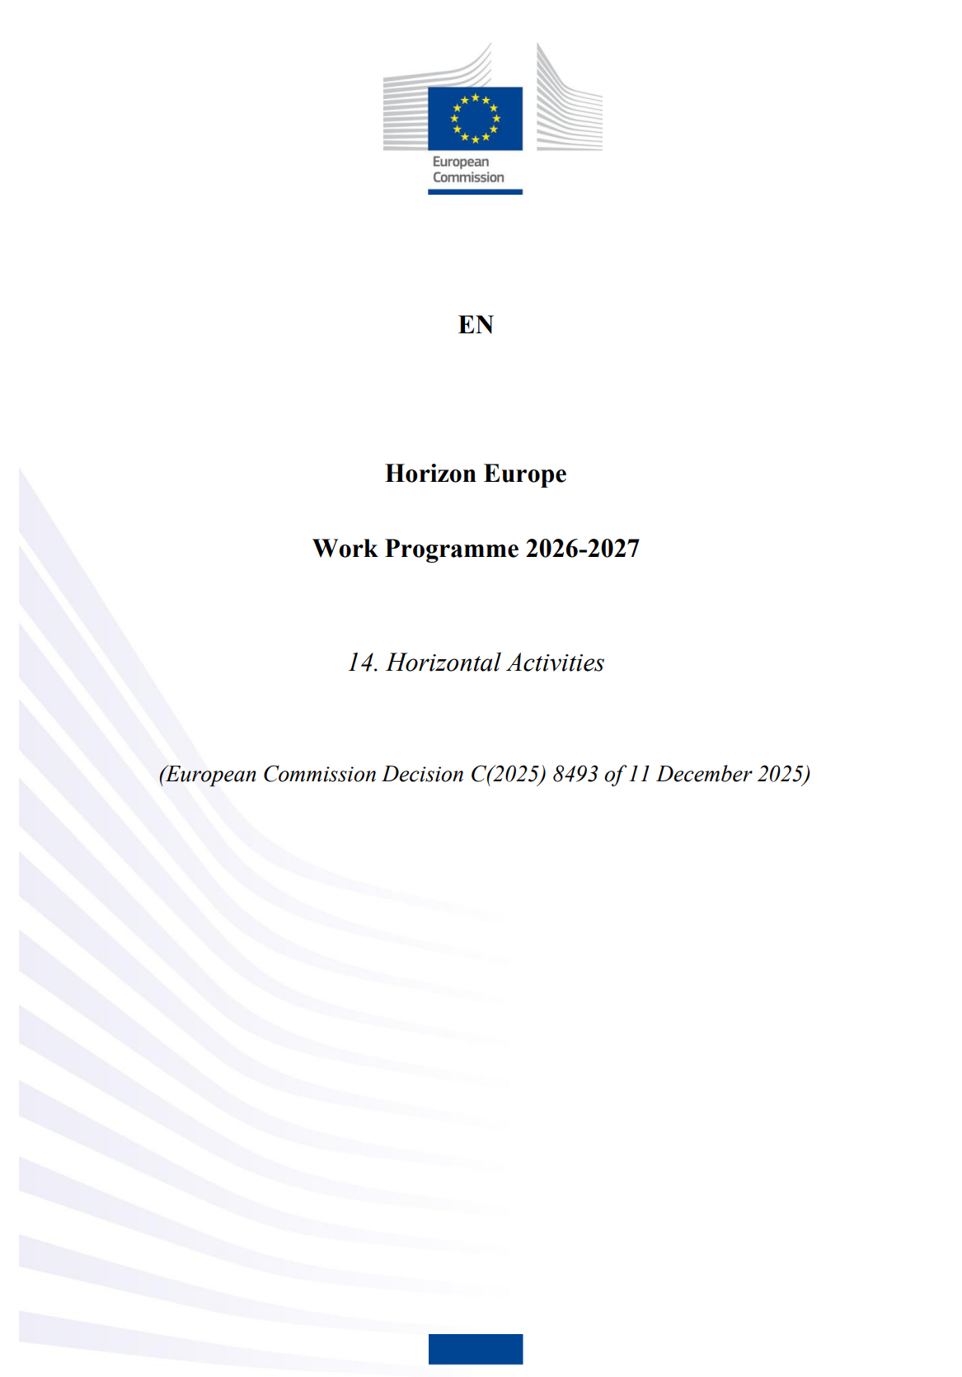
Key Novelties – Other
Horizontal Activities
Horizontal Activities
Groups the horizontal calls
Aims to create critical mass and avoid duplication of budget
Horizontal call - R&I in Support of the Clean Industrial Deal
  HORIZON-CID-2026-01: €275m - 2xIA Call Topics - 16 projects - 15 Sept 2026
  HORIZON-CID-2027-01: €265m - 2xIA Call Topics - 16 projects - 15 Sept 2027
Horizontal call - AI in science
  HORIZON-RAISE-2026-01: €27.8m - 2xRIA Call Topics - 2 projects - 21 April 2026
  HORIZON-RAISE-2027-01: €32m - 2xRIA Call Topics - 4 projects - 02 Feb 2027
Horizontal call - RAISE Doctoral Networks for AI in Science
  HORIZON-RAISE-2026-01-MSCA: €30m - TMA Doctoral Networks - 24 Nov 2026
See also: Horizon Implementation day – Novelties in the 2026-2027 Horizon Europe work programme (20 January 2026)

Slide 13

UK NCP Info Days/Training
Forthcoming events:
Horizon Europe Reapply Masterclass 2026
4 Feb - Bristol; 11 Feb - Edinburgh; 4 Mar - Manchester; 18 Mar - London
Recent events:
Unlocking Horizon Europe Cluster 5 Opportunities: Climate, Energy & Mobility (2026–2027) - 11th Nov 2025
Horizon Europe: Adaptation to Climate Change and 100 Climate-Neutral & Smart Cities - 13th Nov 2025
2026 ERC Proof of Concept Grant - 11th Dec 2025
EIC Pathfinder - DeepRAP: Deep Reasoning, abstraction & planning towards trustworthy Cognitive AI Systems – 11 Dec 2025
EIC Pathfinder Challenges – 2nd / 4th / 11th Dec 2025
EIC Advanced Innovation Challenges (pilot) – 4th Dec 2025
Regularly check: past events & forthcoming events

Slide 14
European Commission Info Days
Cluster 1: Health – 10 Feb
Cluster 2: Culture, creativity and inclusive society – 26 Mar
Cluster 3: Civil security for society – 4 Mar
Cluster 4: Digital, Industry and Space – 29-30 Jan
Cluster 5: Climate, Energy and Mobility – 15 Jan
Cluster 6: Food security, Bioeconomy, Natural Resources, Agriculture and Environment – 22-23 Jan
WIDERA Widening – 22 Jan
EU Missions – 20/21 Jan
Research Infrastructures – 18 Mar
EIC Info Day recording – Nov 2025
Find out more here: Upcoming info days

Slide 15

Thank you
NCP-CrossCutting@iuk.ukri.org

