Slide 1


MSCA Novelties
Raquel Meco Melguizo
MSCA National Contact Point (UK)
12 February 2026

Slide 2


Agenda
1 Quiz
2 Setting the scene
MSCA in Horizon Europe
3 MSCA
Principles and Actions
4 Novelties
MSCA Work Programme 2026-2027
5 Questions

Slide 3
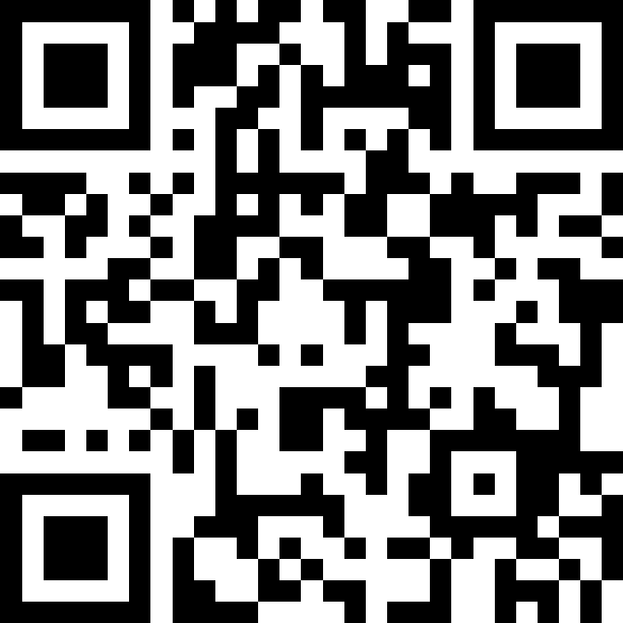
MSCA Quiz
Join at slido.com
#2917 4996

Slide 4
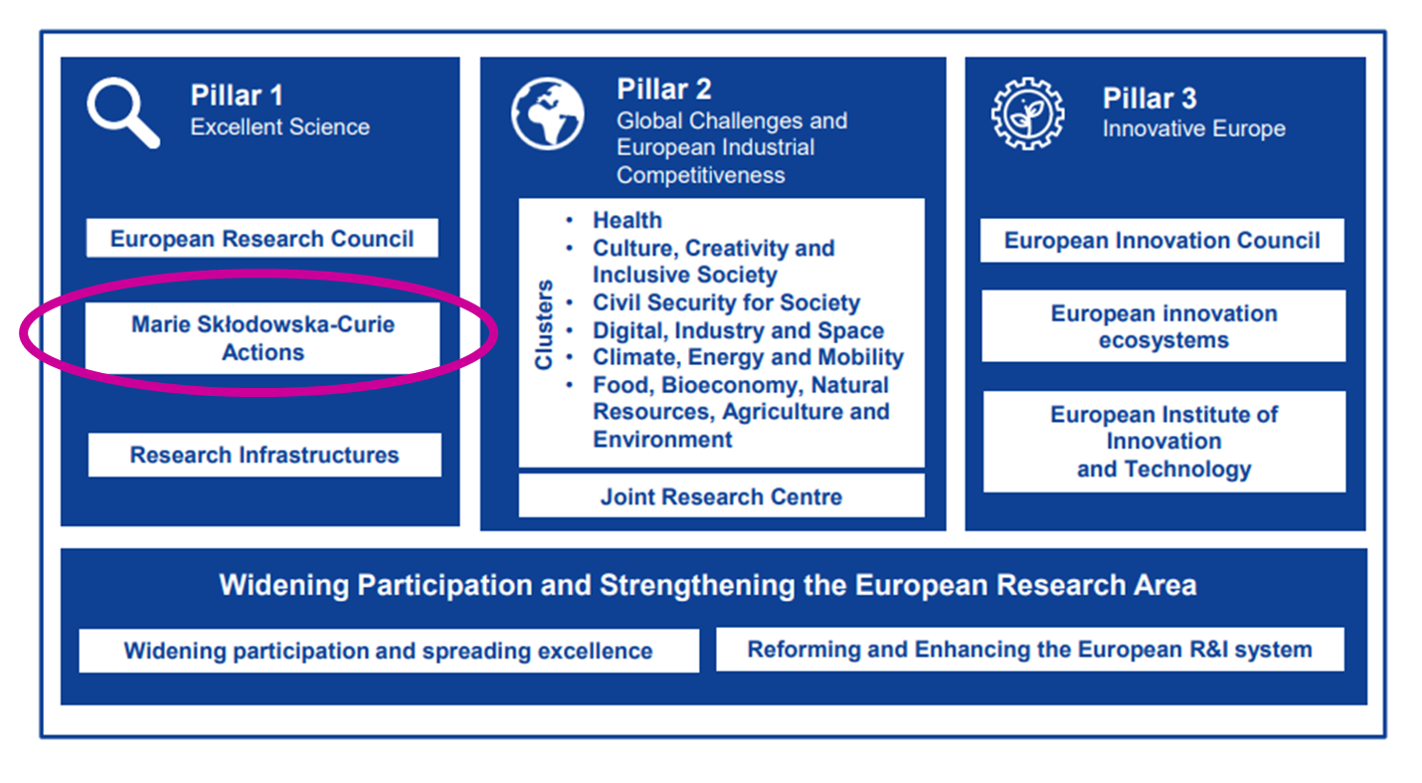
MSCA in Horizon Europe
The EU’s reference programme for doctoral education and postdoctoral training
Equipping researchers
with new knowledge
and skills through mobility
and training
Budget = €6.6billion

Slide 5
MSCA Principles
Excellence
Recruitment and working conditions
Open Science and Responsible Research and Innovation
Mobility
Bottom-up and open to the world
Supervision
European Green Deal

Slide 6
MSCA Actions
Doctoral Networks (DN)
Doctoral programmes in and outside academia, inc. joint & industrial doctorates
Total budget 2026: €593.03 million
Opening call: 28/05/2026
Deadline: 24/11/2026
Postdoctoral Fellowships (PF)
Support to excellent postdoctoral researchers
Total budget 2026: €399.05 million
Opening call: 09/04/2026
Deadline: 09/09/2026
Staff Exchanges (SE)
Support for research and innovation staff exchanges
Total budget 2026: €97.92 million
Opening call: 16/12/2025
Deadline: 16/04/2026
COFUND
Co-funding doctoral and postdoctoral programmes
Total budget 2026: €105.46 million
Opening call: 16/12/2025
Deadline: 08/04/2026
MSCA and Citizens
Public outreach events aiming to bring research and researchers closer to the public
There will not be a call in 2026
Choose Europe for Science (CEfS)
Co-funding postdoctoral programmes
There will not be a call in 2026

Slide 7
Novelties – All Actions
Introducing a minimum score threshold of 3 on all evaluation criteria (‘Excellence’, ‘Impact’ and ‘Quality and efficiency of the implementation’)
Including AI in the list of transferrable skills
Reference to restrictions on participation of certain Chinese universities
Increasing 2026-2027 living/top-up allowances
Increasing the maximum duration of secondments from 1/3 to half of the fellowship duration

Slide 8
Novelties – Particular Actions
For DN and PF only, increasing the UK’s Country Correction Coefficients (CCC) that applies to the living allowance from 141,7% to 143,5%
For PF only, increasing re-submission score to 80% to align with DN
For DN, relaxing the enrolment rule in doctoral programmes for beneficiaries from non-associated Third Countries
For SE, relaxing eligibility conditions to allow same-sector secondments, inc. dropping the 1/3 rule on interdisciplinarity
For SE, removing the 1-month employment prior to the secondment rule

Slide 9
Resources/ Upcoming MSCA sessions
Resources | MSCA Information webinars
EU Funding & Tenders Portal MSCA 2026-2027 Work Programme MSCA Financial Guide MSCA Guidelines on Supervision Our MSCA Factsheets RADIANCE project | MSCA COFUND 2026 Call Information webinar, 5 February, 10:00-12:00. Recording will be available soon! MSCA Staff Exchanges 2026 Call Information webinar, 24 February, 10:00-12:00 MSCA Doctoral Networks, 25 June, 10:00-12:00. Registration details will follow soon.

Slide 10

Nothing in life is to be feared, it is only to be understood. Now is the time to understand more, so that we may fear less.
Marie Skłodowska-Curie
mariecurie-uk@ukro.ac.uk

