Slide 1
Preparing Horizon Europe Applications
Marie Adams
University of Leicester
marie.adams@leicester.ac.uk

Slide 2

Leicester’s Horizon Europe support
Small team, diverse workload, high-volume
Embedded in the central Research and Enterprise Division
Part of a wider research support ecosystem
Provide…
  Specialist funder knowledge
  Advice and signposting
  Costing and contracting support
  Post-award financial support
  News and events
  Training

Slide 3
University of Leicester: a sense of scale...
In 2024/25 the University Horizon Europe applications increased by over 55% in number and 70% in value.
In 2025/2026 we passed 2024/25 application numbers and values in Q1!
Problem!
Large multi-national, multi-sector consortia.
Top down - policy alignment key.
Competitive with diverse criteria for success.
Limited resource.

Slide 4
Solutions:
Horizon Europe – a plan for (sustainable) growth.
One to one when necessary, one to many preferred.
Internal resources; online ‘toolkit’, templates, successful bids.
Leveraging additional support – academic champions, mentors.
Utilise existing infrastructure – research institutes, seminar series, research committees.

Slide 5
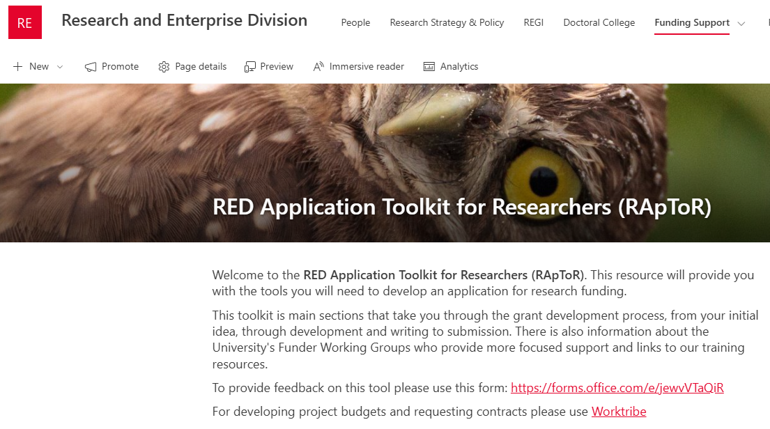
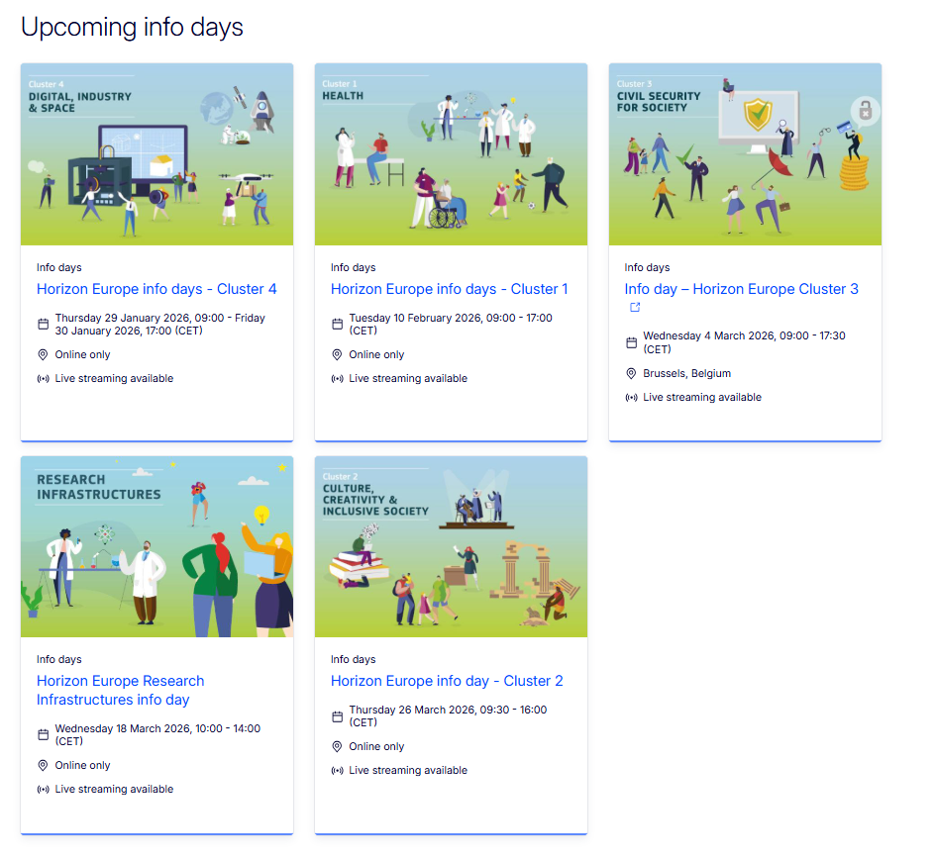

Collaborative proposal development
Our role in preparing applications & facilitating collaboration
Start early (now!) - target opportunities in areas of strategic importance, highlight events and Info Days. Establish research leadership.
Evaluate opportunity for a cohort approach.
Assist in navigating internal rules and processes;
  Engage other teams early e.g. pre-award, research governance etc.
Establish roles, timelines and boundaries.
Help applicants understand the call text and individual call requirements/nuances.

Slide 6

Potential obstacles
…not an exhaustive list!
Budget redistribution and caps.
Waivers of internal policies and costs (e.g. tuition fees, overheads).
IP protection required.
Clinical trials and ethical issues.
Enhanced due diligence requirements.
Up front agreements e.g. NDA’s, LoI’s.
Additional requirements at proposal stage (novelties, lump sum, unfamiliar application process).
Cultural, organisational and disciplinary differences.

Slide 7


Slide 8


Slide 9


MSCA PF 2026 CALL DEADLINE

Slide 10


MSCA PF 2026 CALL DEADLINE
NCP INFO EVENT

Slide 11
MSCA PF 2026 CALL DEADLINE
INFO EMAIL
NCP INFO EVENT

Slide 12
DIY CONCEPT REVIEW
MSCA PF 2026 CALL DEADLINE
INFO EMAIL
NCP INFO EVENT

Slide 13

DIY SUMMER SCHOOL
DIY CONCEPT REVIEW
MSCA PF 2026 CALL DEADLINE
INFO EMAIL
NCP INFO EVENT

Slide 14
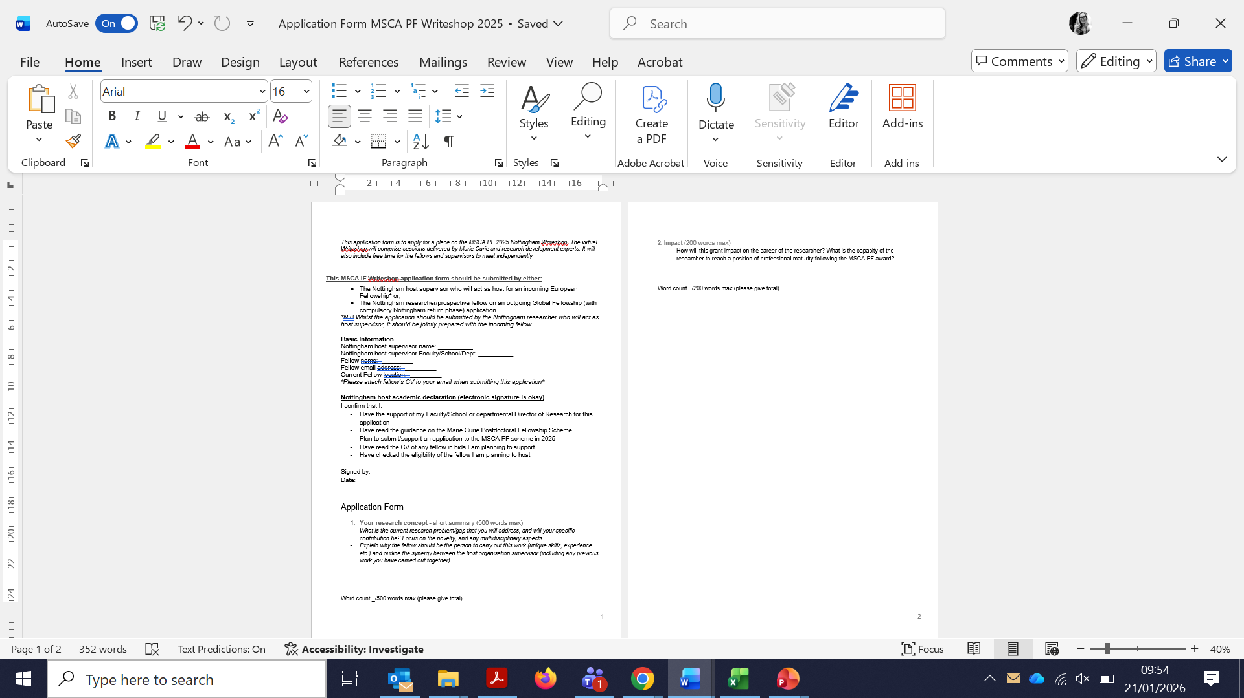
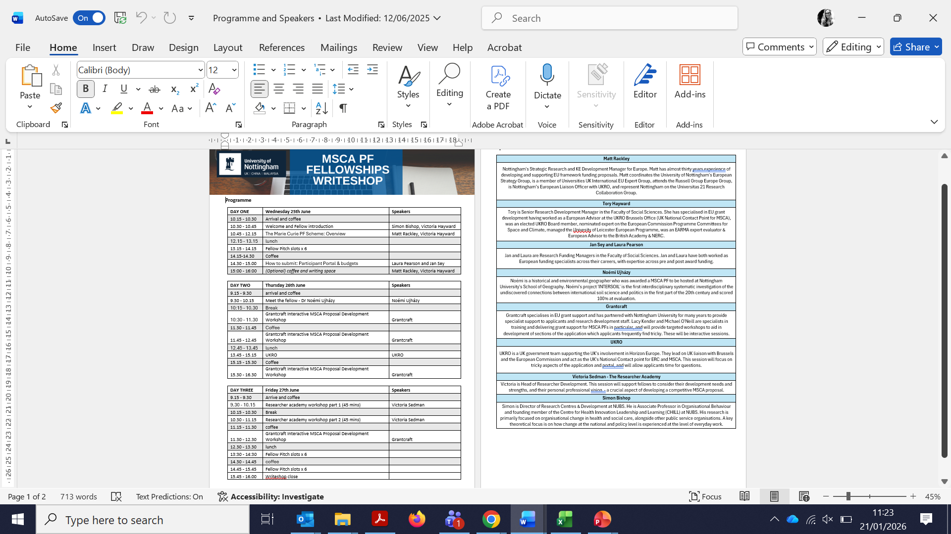
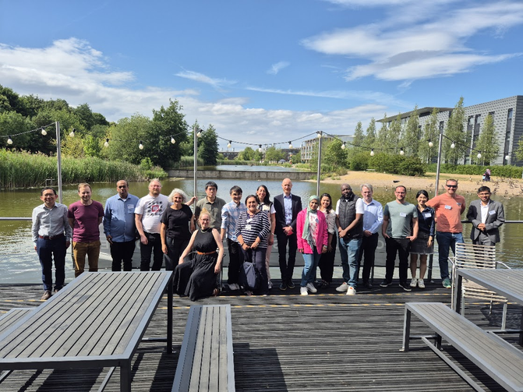
DIY SUMMER SCHOOL
DIY CONCEPT REVIEW
MSCA PF 2026 CALL DEADLINE
INFO EMAIL
NCP INFO EVENT

Slide 15


Slide 16
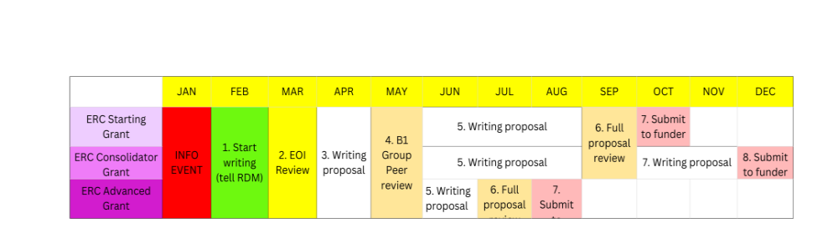
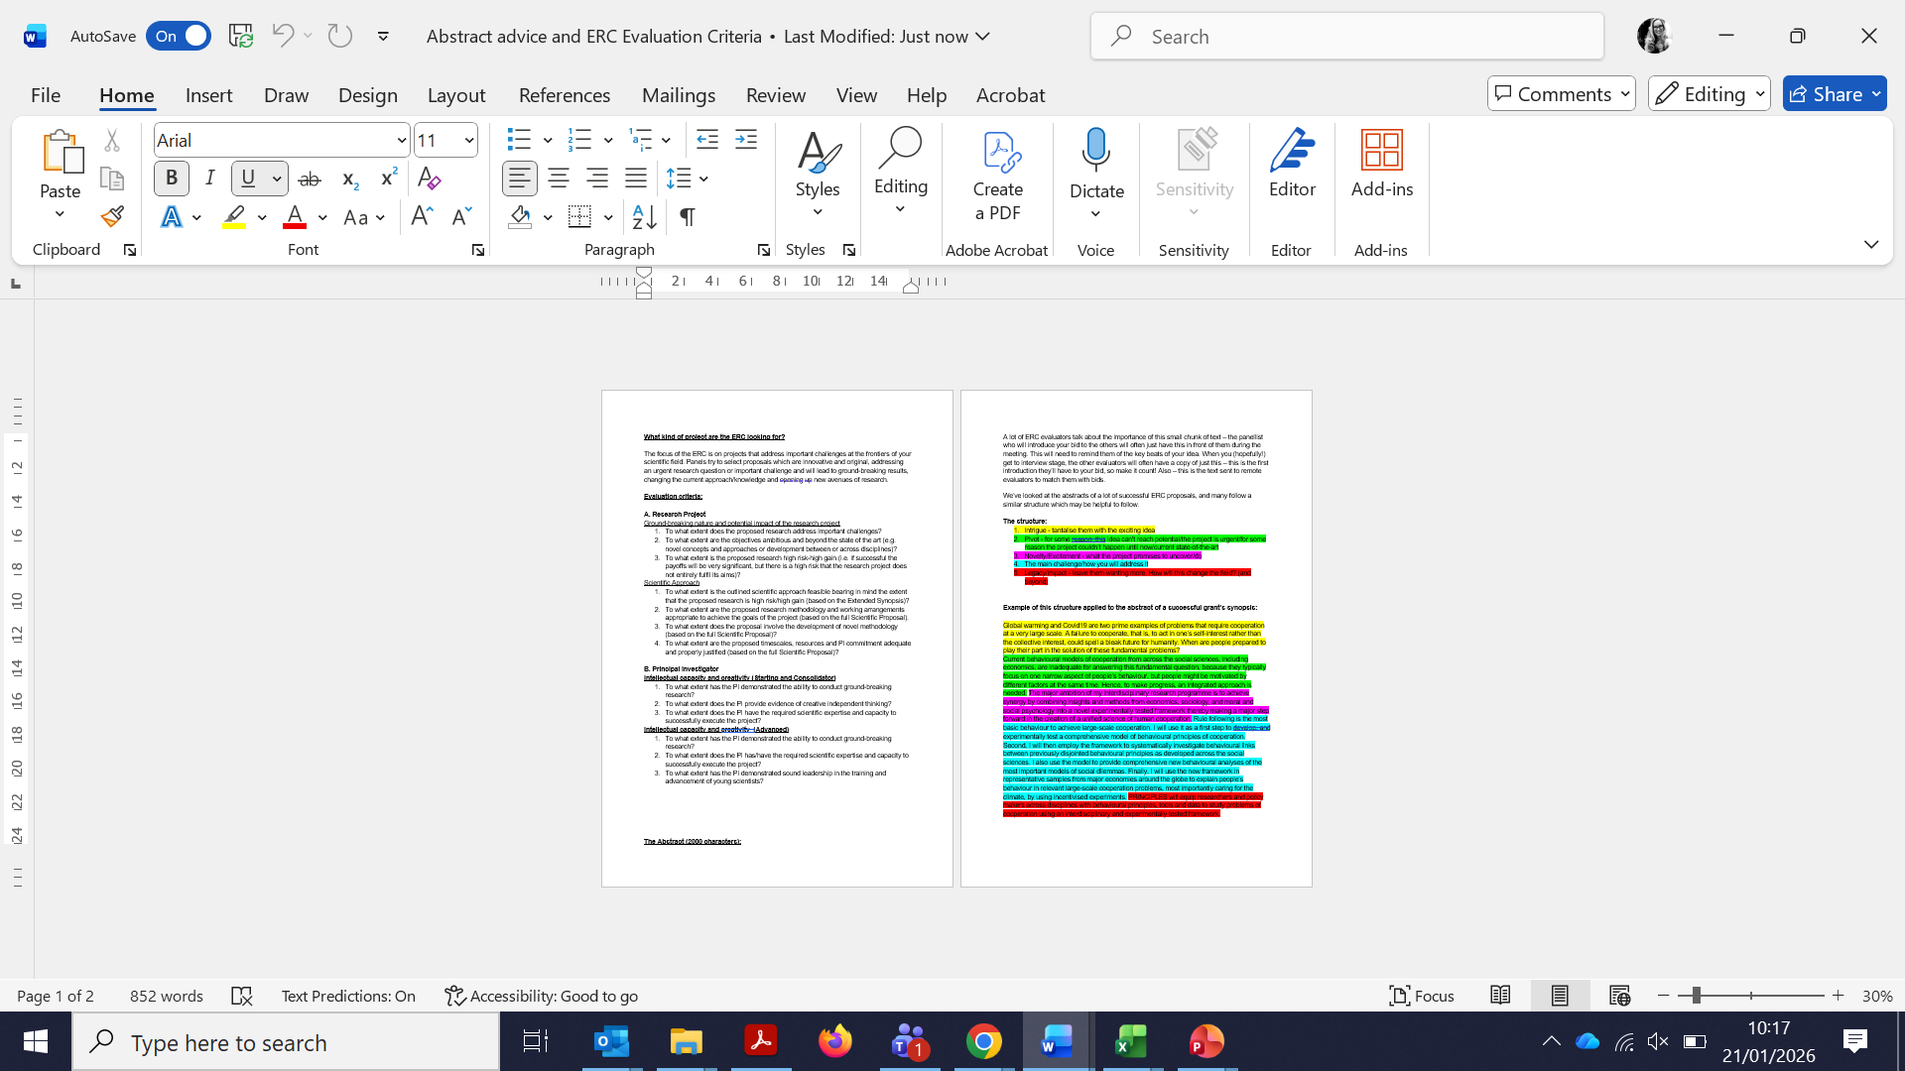
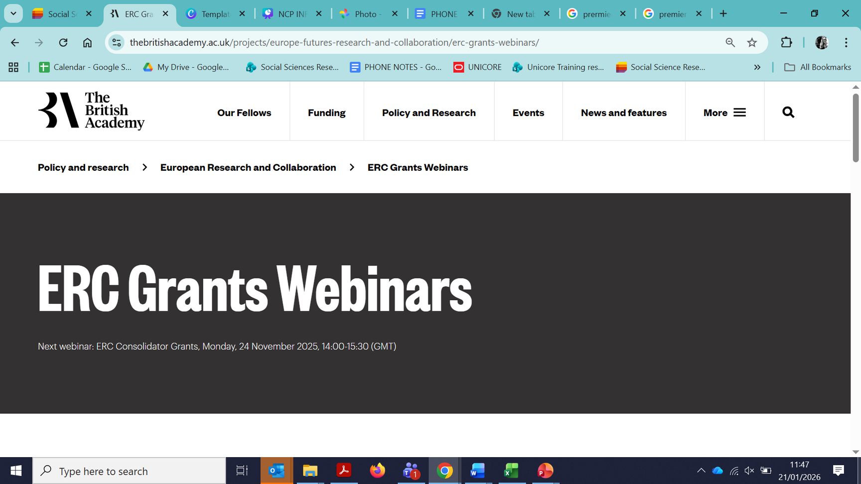

Slide 17

Over to you!

Slide 18



Do not edit
How to change the design
What is your biggest challenge in developing a competitive Horizon Europe proposal?
The Slido app must be installed on every computer you’re presenting from

Slide 19
Do not edit
How to change the design
What support, resource or action would most help you overcome this challenge?
The Slido app must be installed on every computer you’re presenting from

Slide 20
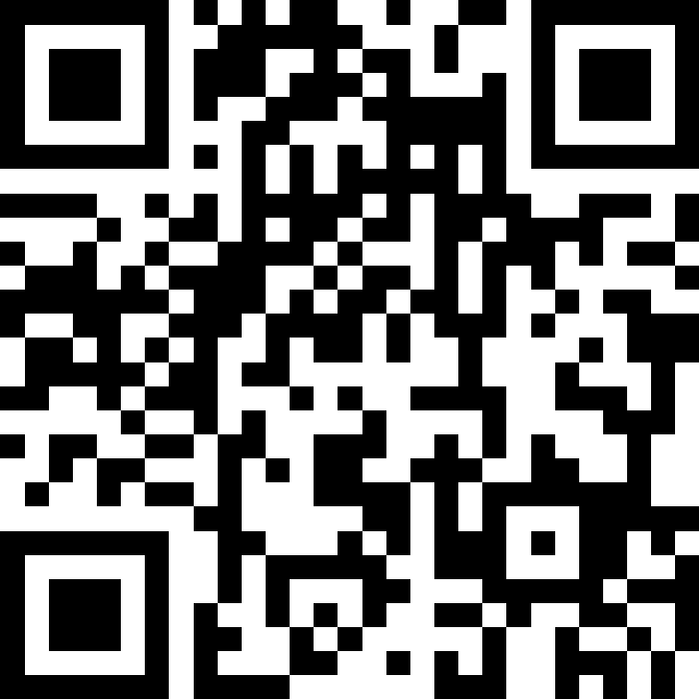

What is your biggest challenge in developing a competitive Horizon Europe proposal?
What support, resource or action would most help you overcome this challenge?

Slide 21

Thank you for your attention.
Time for questions and discussion.

