Slide 1

Horizon Europe
Research Manager Event, Leeds
Two years to go - what do we do next?
Franziska Enichlmayr
Policy Officer (Europe)
12 February 2026

Slide 2

About UUK: our strategy & priorities
Universities UK is the collective voice of 142 universities across the UK. Our mission is to help UK universities be the best in the world, through their research and teaching, and the positive impact they have locally, nationally and globally.
Policy priorities:
Securing a sustainable, competitive environment for international staff and student recruitment;
Enhancing the scale, scope and impact of the UK’s global R&I activities;
Delivering growth in and effective regulation of Transnational Education;
Maximising international experiences for UK-based students;
Managing and mitigating the risks of international engagement.

Slide 3

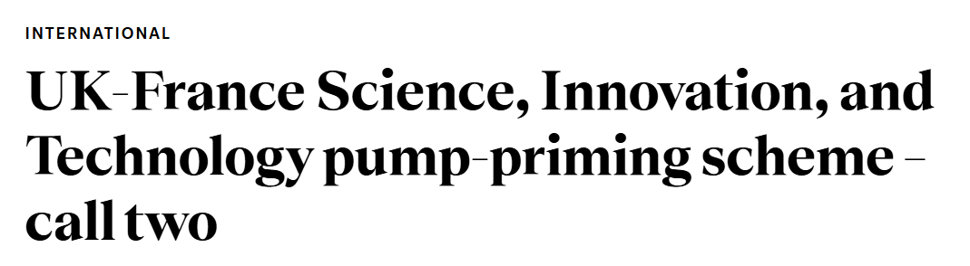
Successes in 2024 and 2025
Participation/successes 2024 and 2025:
      Pillar I: Bounced back strongly (ERC and MSCA)
      Pillar II: Bounced back less strongly
      Pillar III: Notable UK engagement in the EIC, not as much in other schemes
      Indication that 80% of UK participation is HEIs.

Slide 4

2026 and 2027
Boost participation - lots of opportunities still!
Champion areas where we do particularly well (Pillar I).
Continue driving Pillar II (and Pillar III) despite challenging context.
Share best practice/capacity build (events like today!).
Continue proactive engagement: EU MS, associated countries, LMICs, Brussels.

Slide 5
FP10 and European Competitiveness Fund
Draft MFF 2028-2034
EU/DSIT budgets: good news/bad news
Likeminded trusted countries
Proactive associated country voice: meeting with Commission representatives on 4 December, MEP session in collaboration with EUA on 14 January
​ | 2025/2026 ​ | 2026/2027 ​ | 2027/2028 ​ | 2028/2029 ​ | 2029/2030 ​ | Total ​
EU programmes (cash terms, £m) ​ | 2,736 ​ | 2,121 ​ | 2,195 ​ | 2,200 ​ | 2,200 ​ | 8,716 ​
Notes:
​

Slide 6
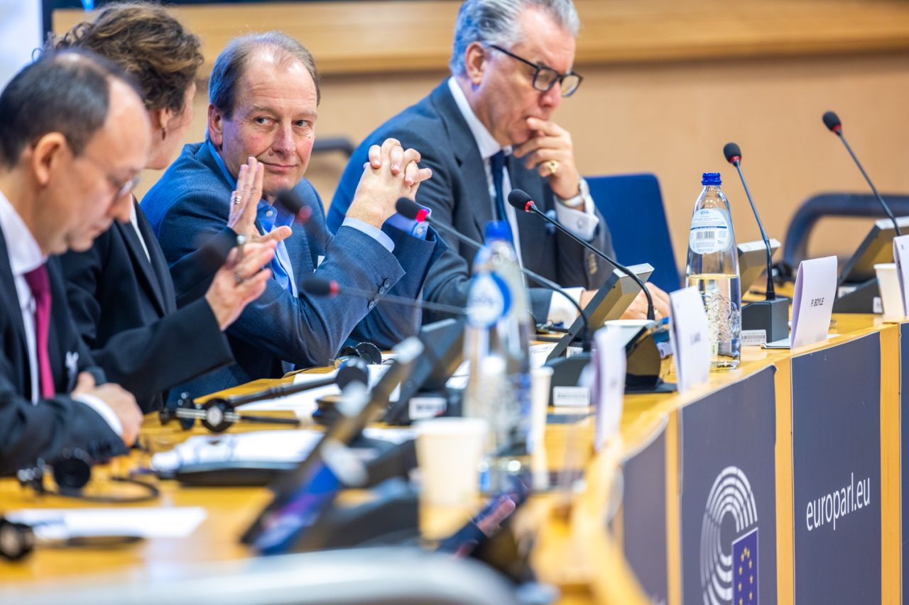
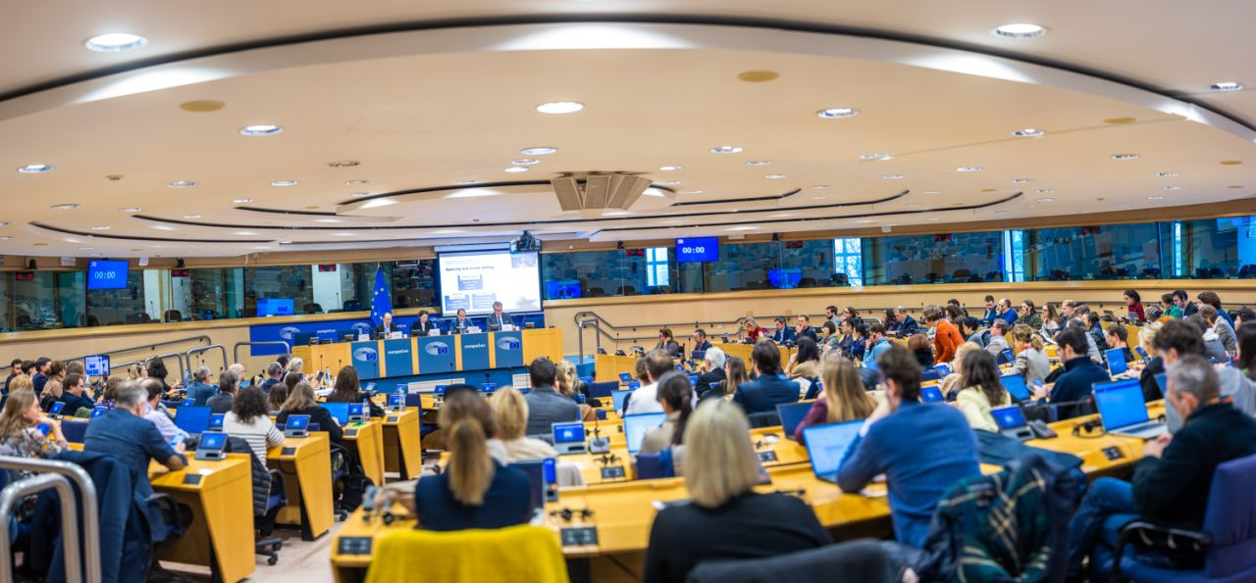
Harnessing a joint UK approach
      UUKi - six Horizon Europe delegations to MS/ACs, UK-France pump-priming and researcher mobility scheme, Brussels engagement (incl. EUA).
      DSIT - recently specifically focussed on Germany and Spain; brokerage events; Horizon Europe as part of bilateral dialogues
      Better connectivity across the system: NCPs, feedback mechanism, draft WPs.
      Addressing gaps (incl. industry participation).
      Thinking strategically and long-term.
Notes:
J

Slide 7


Slide 8
Thank you
Franziska Enichlmayr, Policy Officer (Europe), franziska.enichlmayr@international.ac.uk ​
Find us online: https://www.universitiesuk.ac.uk/universities-uk-international​
LinkedIn: Universities UK International

